Slide 1
Distributed Control and Automation Framework (DCAF)
Module Reuse
Benjamin Celis, Mathew Pollock, Simon Perez

Slide 2
Agenda
Class Project 1
Runtime Templates
Configuration Editor
Finding Modules
Configuration File

Slide 3
Agenda
Defining this chapter project.
Deciding on Runtime template
Exercise 1
Use runtime template
Explain parts of the template
Getting available modules,
Module Search path
Exercise 2
Getting new module
Adding it to search Path
Exercise 3
Create configuration
Script Includes
Deploy Tool
Notes:
On this lesson we will

Slide 4
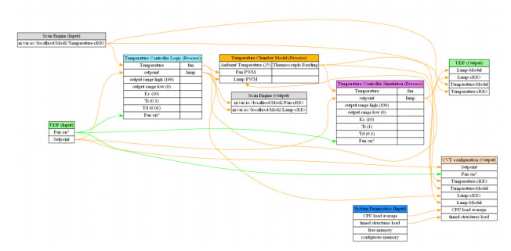
Exercise Project With Hardware
2 Engines
UDP for E3E
Temperature control
Acquire Data Scan Engine
PID Control
Log To Disk
UI
Notes:
Provide UI

Slide 5
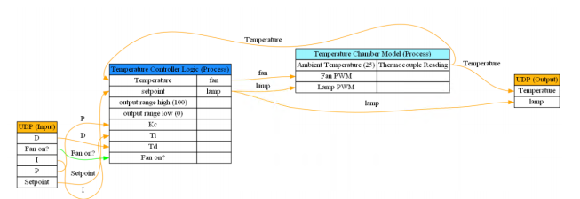
Exercise Project without Hardware
2 Engines
UDP for E3E
Temperature control
Acquire Data Scan Engine
PID Control
Log To Disk
UI

Slide 6
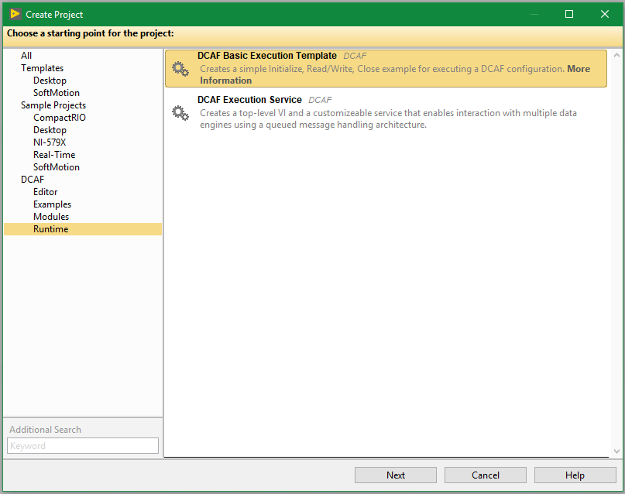
Runtime Templates

Slide 7
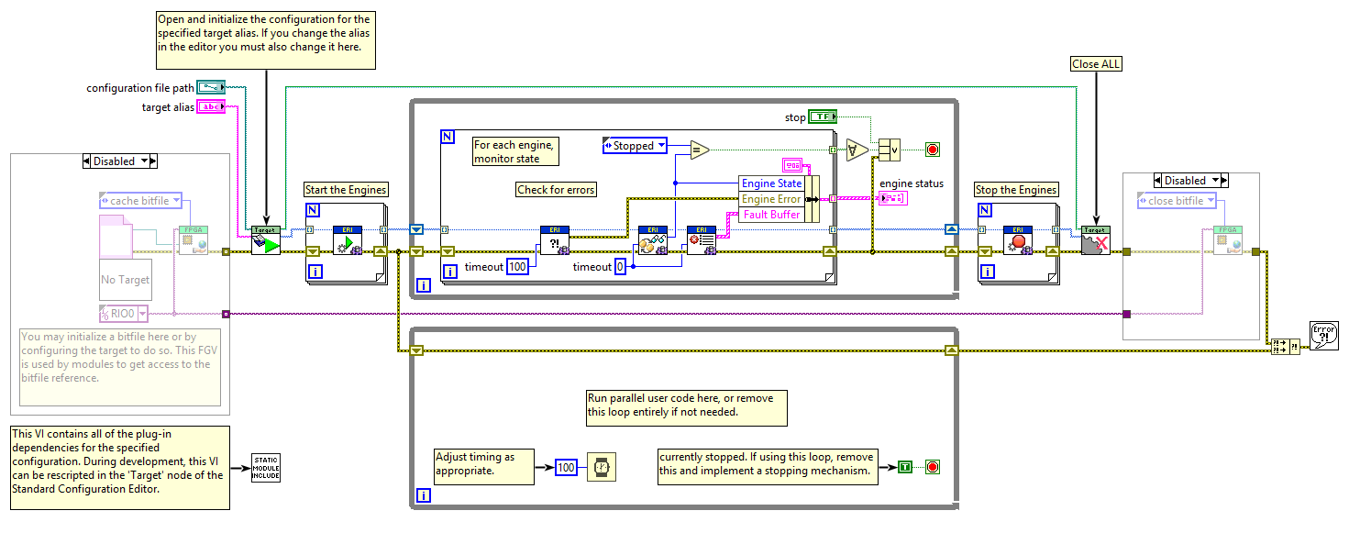
Basic Execution Template

Slide 8
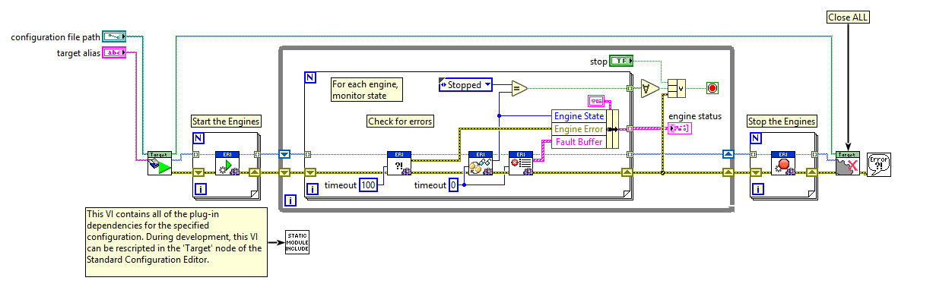
Most Common Case of the template

Slide 9
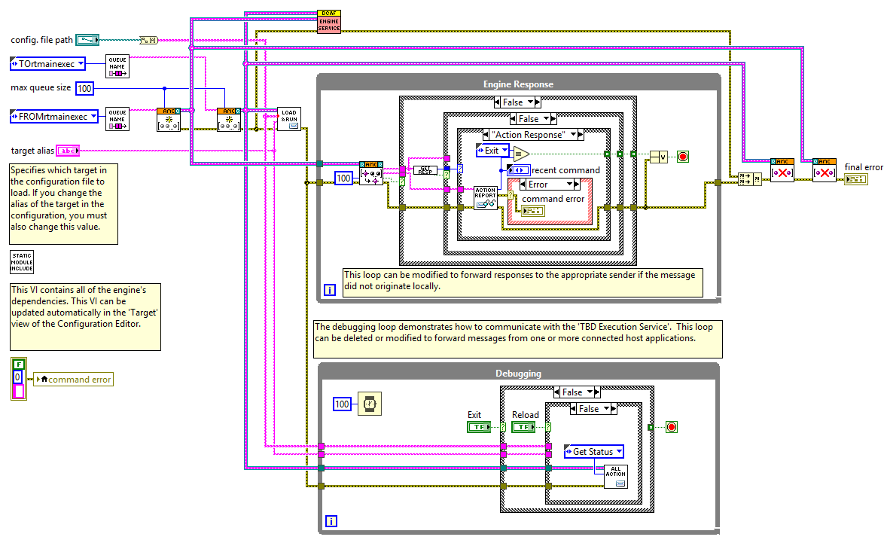
Services template

Slide 10
Exercise 1
Hands On Exercise 1 Part A

Slide 11
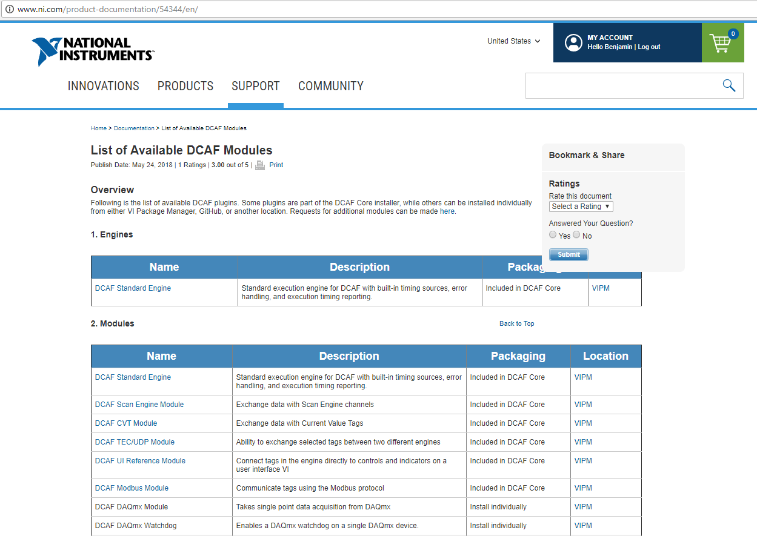
Available DCAF Modules
Notes:
http://www.ni.com/product-documentation/54344/en/

Slide 12
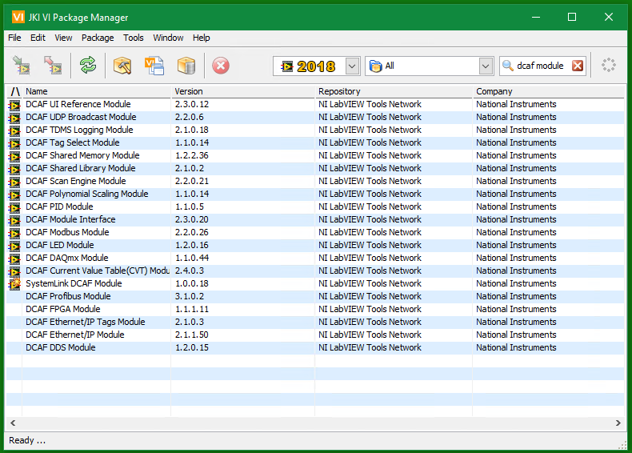
Available DCAF Modules

Slide 13
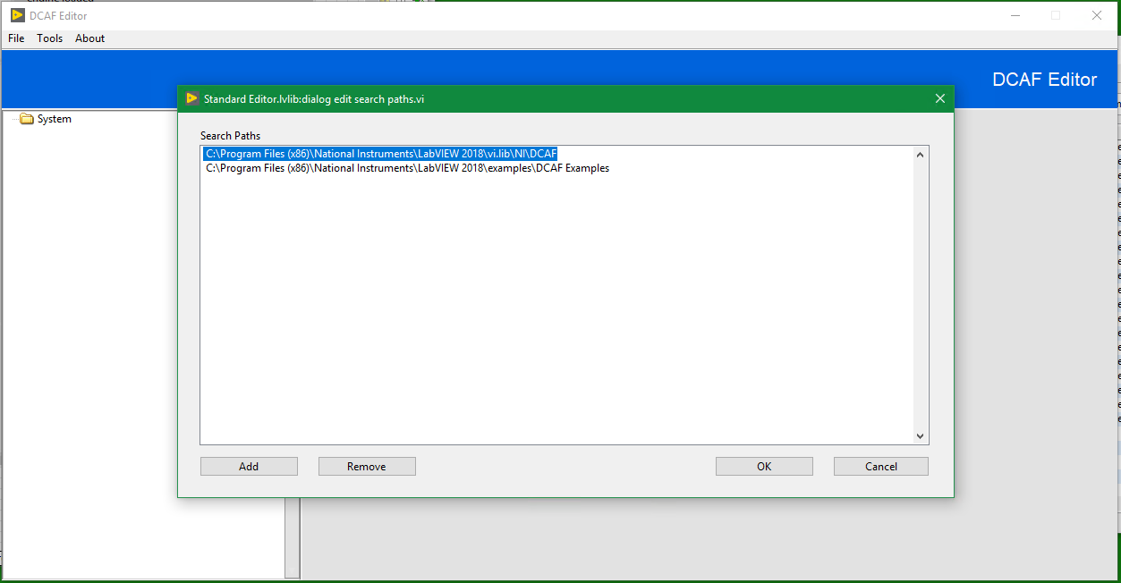
Search Paths

Slide 14
Exercise 2
Hands On Exercise 1 Part B

Slide 15
Exercise 3 (optional)
Hands On Exercise 1 Part C

Slide 16
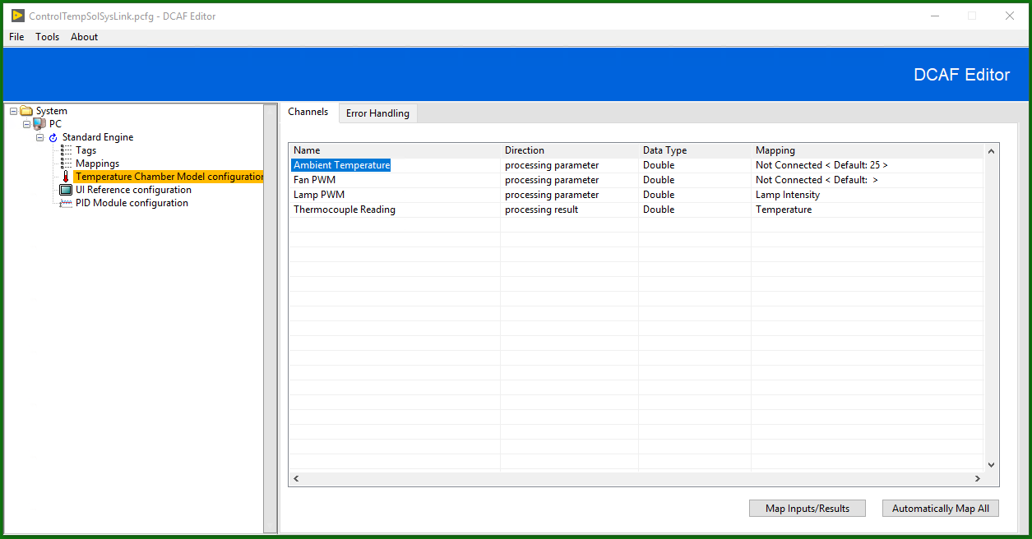
What type of module do I need

Slide 17
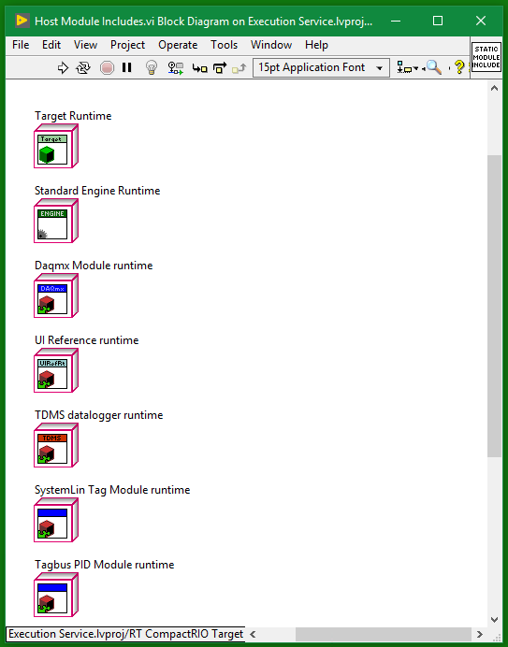
Script Includes
You should run this every time you add new modules to the configuration
It updates the includes VI

Slide 18
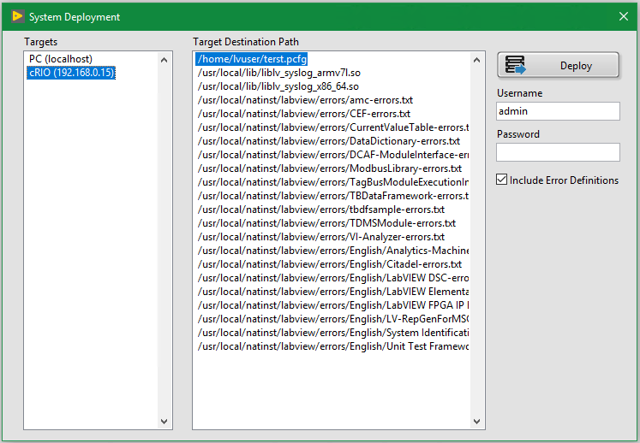
Deployment

Slide 19
Conclusion
Before creating modules check available modules
Choose the right execution template
Create the configuration
Update include VIs
Deploy Configuration
Most likely you will need at least 1 custom module most likely a static module and that is cover on the next session

